Slide 1
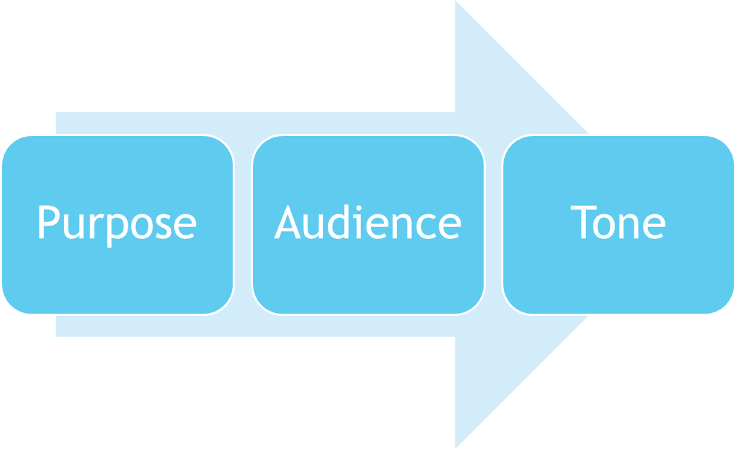
The Writing Process: Thinking before Writing

Slide 2


The Writing Process
These three elements work together. You can’t consider one without the other. They may also save you a lot of time if you think about these elements before you write.
Notes:
Purpose:
reason you want to express

Slide 3

Purpose
Purpose: The reason you want to express yourself on paper.
  What information do you wish to convey?
  What are the parameters of the assignment?
  How broad is the subject?
  What can I include?
  What can I leave out?

Slide 4
Audience
        The College Audience: A group of educated adults
Who would be most interested in this topic? (Narrow/Tailor the audience)
What do they already know about the topic? (leads back to purpose-narrow the topic

Slide 5

College Audience
“Educated”- means that the adults are aware of history, current events, political and social concerns, etc. They are not experts, but simply aware of the world around them.
Hint: You can narrow your Essay by also narrowing or tailoring the audience.

Slide 6
Tailored Audience
Let’s say we are going to write on the topic of School Violence.
The group of educated adults might be too large, so narrow the Audience:
Who would be interested in School Violence?
  Parents Police
  Teachers Students
  School Administrators
  Community Activists

Slide 7
Tailored Audience
When the audience shrinks, the Essay becomes more detailed; it has more focus.
The examples you include for Parents, will be significantly different for Students. Your approach will differ depending on the knowledge, age, maturity of the audience.

Slide 8
Tone
Tone: Level of diction, level of language you choose to use for the audience.
Tone is determined by your Audience, your writing style, and the actual assignment, or Purpose of the writing.
  Is the tone serious, matter of fact, humorous?

Slide 9
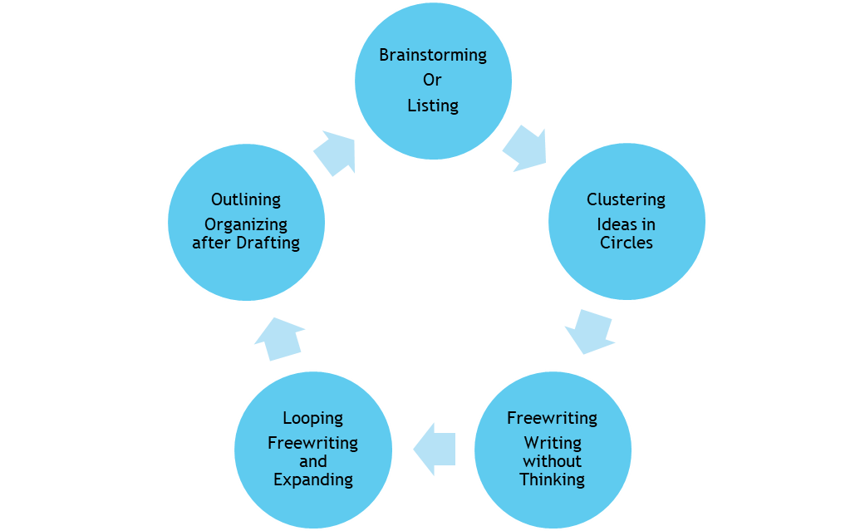
Prewriting Skills to Avoid Writer’s Block

Slide 10
Prewriting
Free writing: The “free” aspect is that you are writing before you brain has time to criticize you. Don’t think, just write. Don’t think about:
Punctuation
Grammar
Order of ideas
Staying on topic

Slide 11
Prewriting Tips
Surprise Yourself: Don’t just stick to the same old Prewriting Skills, mix it up a bit.
If you hate to stare at a blank page, use Free writing. It gets words on the page immediately. Looping is also helpful in extending your ideas and creating additional details that were not there in the previous freewriting.
Use more than one skill: Brainstorm to find the topic, Cluster to narrow the topic, Free write to find if you really have something to say on the topic.

Slide 12
Freewriting Prompts
Prompts:
  If I had the courage I would____________
  Some people think that I am_______, but I am actually___
  The world today is crazy. Just yesterday I heard_________
  I hope this school year will be__________
  I am worried most about__________
  I am happiest about_____________
  If I looked like__________, I would___________

Slide 13
Looping Technique
Once you have worked on a freewriting for 5-10 minutes, you can use Looping in order to add details, expand the ideas, or even to see if the topic is important enough to you to go further. It may also help you to find a strong focus for formal essays.
1. Find the most important sentence, phrase, or idea on the subject within your first freewriting.
2. Write a one sentence summary of that most important idea. Write it at the top of a new page.
3. Use this summary to begin a new loop of the freewriting. Begin to focus just on this aspect of the freewriting to build in deeper ideas and details.

